Slide 1
Network Applications: Operational Analysis; Load Balancing among Homogeneous Servers
Qiao Xiang
https://qiaoxiang.me/courses/cnns-xmuf22/index.shtml
10/11/2022
This deck of slides are heavily based on CPSC 433/533 at Yale University, by courtesy of Dr. Y. Richard Yang.

Slide 2
Outline
Admin and recap
HTTP
Basic design: HTTP 1.0
HTTP "acceleration"
Operational analysis
Multi-servers
Application overlays (peer-to-peer networks)

Slide 3
Admin
Lab assignment 2 due Oct. 13

Slide 4
Recap: Latency of Basic HTTP/1.0
>= 2 RTTs per object:
TCP handshake --- 1 RTT
client request and server responds --- at least 1 RTT (if object can be contained in one packet)
TCP SYN
TCP ACK
TCP/ACK; HTTP GET
base page
TCP SYN
TCP ACK
TCP/ACK; HTTP GET
image 1
Notes:
Typical approaches to reduce latency:
parallel TCP connections
persistent HTTP
cache and conditional GET

Slide 5
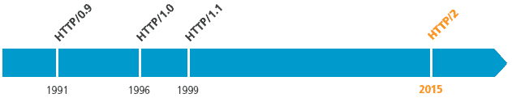
Recap: Substantial Efforts to Speedup HTTP/1.0
Reduce the number of objects fetched [Browser cache]
Reduce data volume [Compression of data]
Header compression [HTTP/2]
Reduce the latency to the server to fetch the content [Proxy cache]
Remove the extra RTTs to fetch an object [Persistent HTTP, aka HTTP/1.1]
Increase concurrency [Multiple TCP connections]
Asynchronous fetch (multiple streams) using a single TCP [HTTP/2]
Server push [HTTP/2]

Slide 6
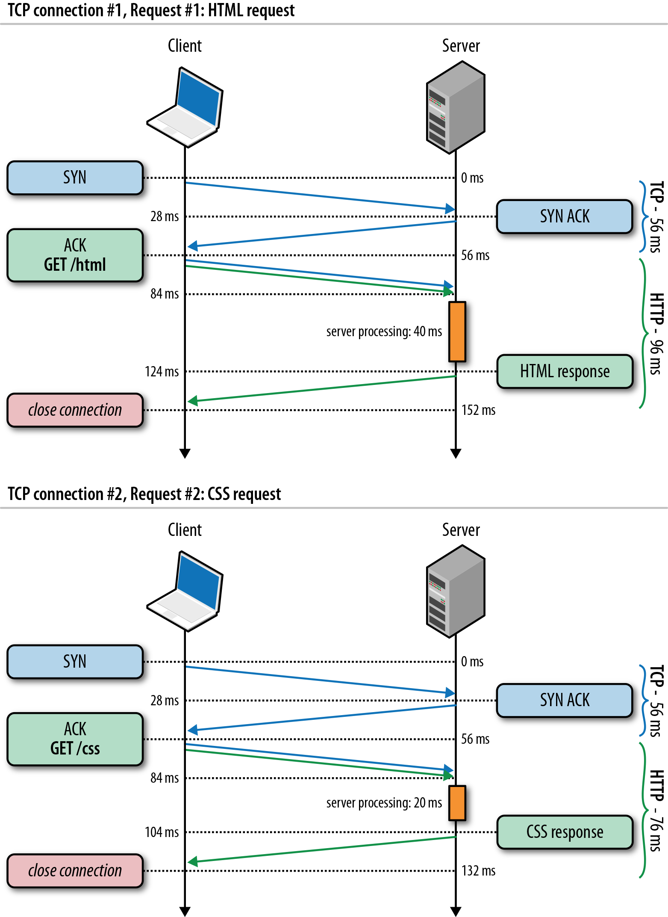
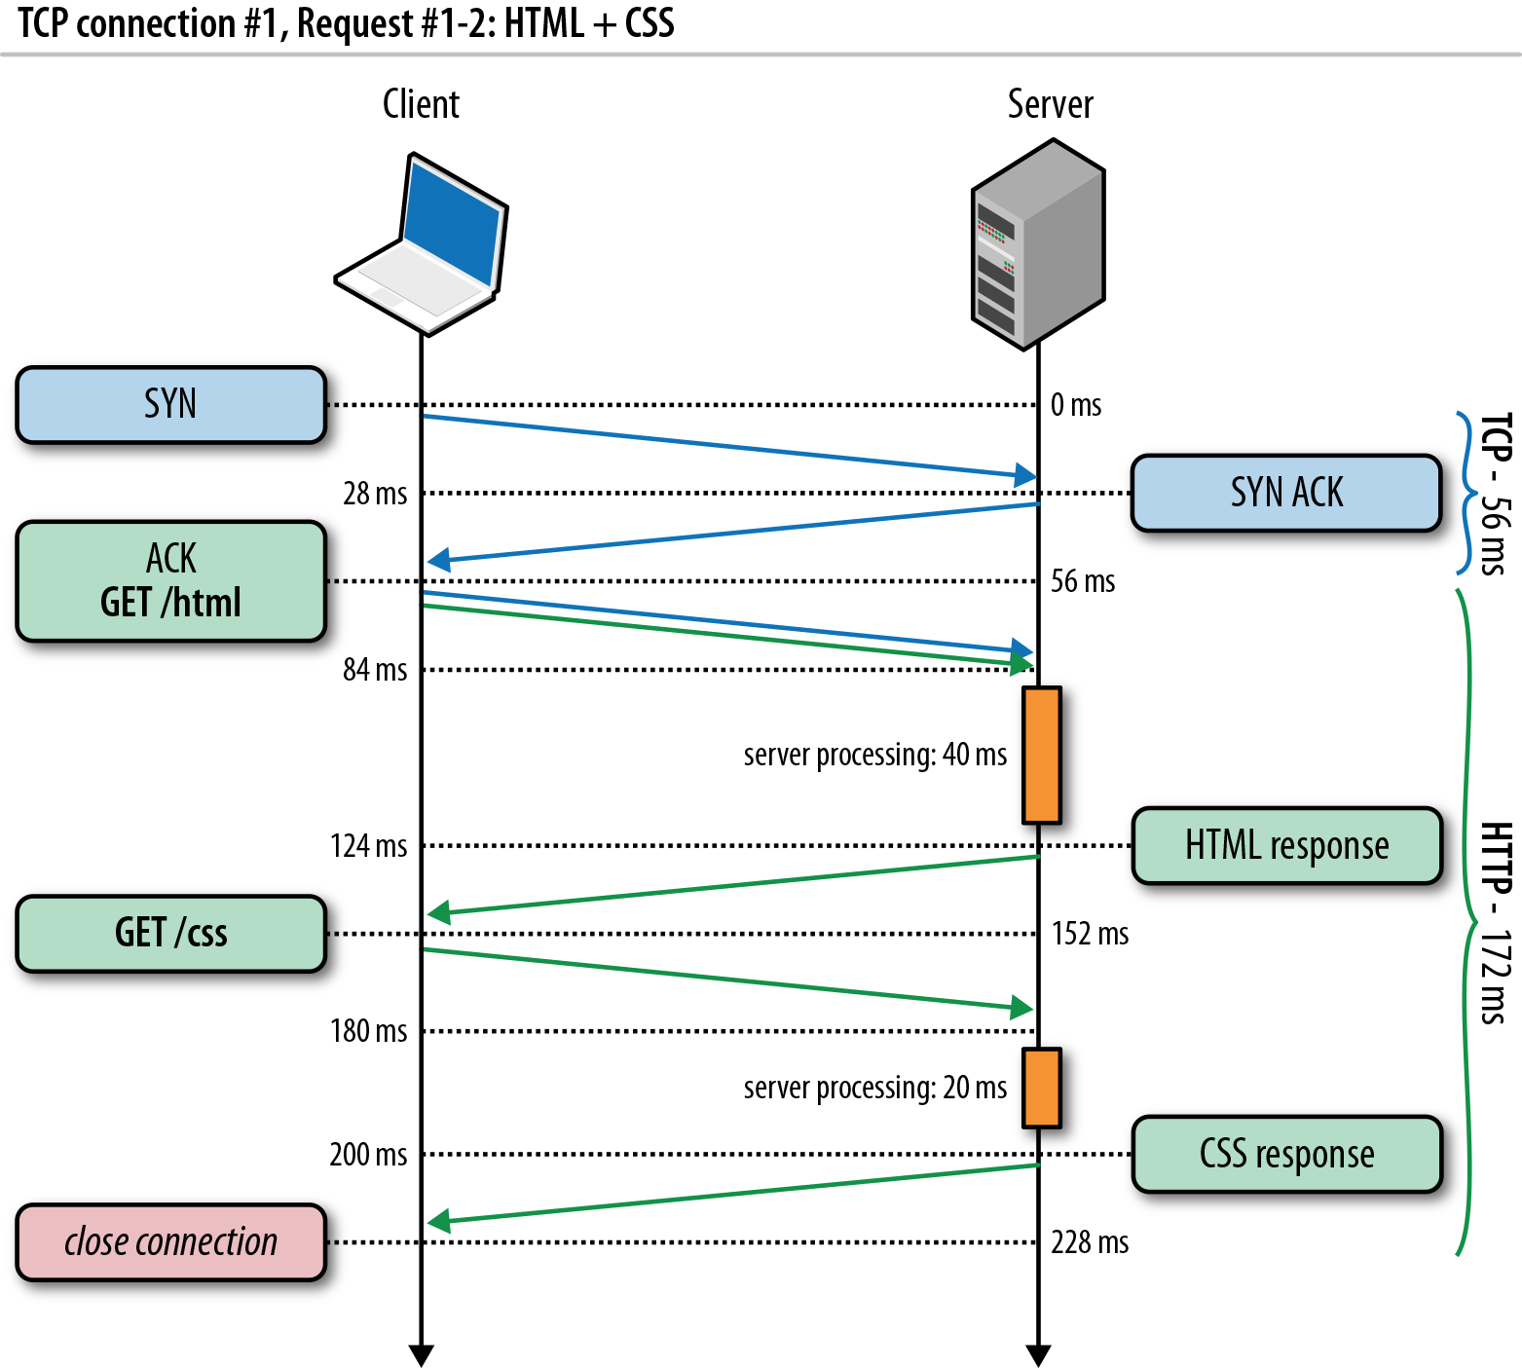
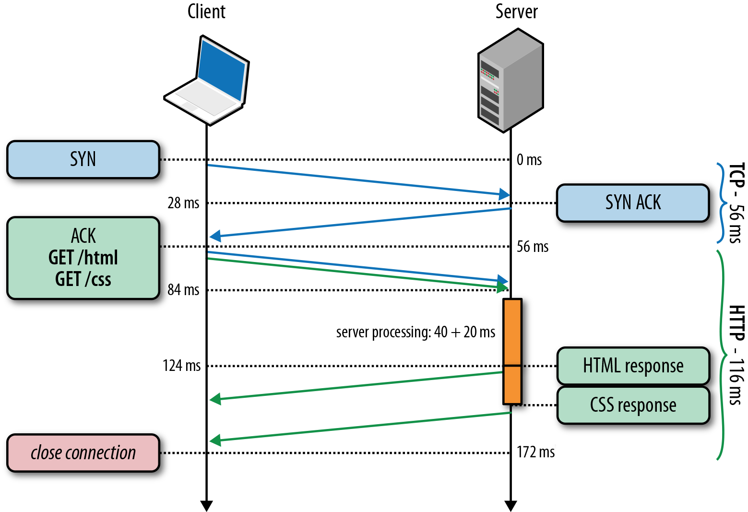
Recap: HTTP/1.0, Keep-Alive, Pipelining
Is this the best we can do?
Source: http://chimera.labs.oreilly.com/books/1230000000545/ch11.html
Notes:
https://httpd.apache.org/docs/2.2/howto/ssi.html

Slide 7
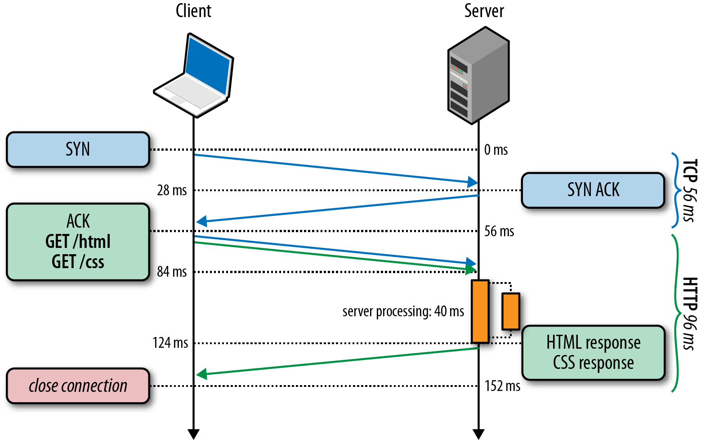
HTTP/2 Basic Idea: Remove Head-of-Line Blocking in HTTP/1.1
Data flows for sequential to parallel: two requests must be concurrent.
Demo: https://http2.akamai.com/demo
Source: http://chimera.labs.oreilly.com/books/1230000000545/ch11.html
Notes:
https://httpd.apache.org/docs/2.2/howto/ssi.html

Slide 8
Observing HTTP/2
export SSLKEYLOGFILE=/tmp/keylog.txt
Start Chrome, e.g.,
Mac: /Applications/Google Chrome.app/Contents/MacOS/Google Chrome
Ubuntu: firefox
Visit HTTP/2 pages, such as https://www.tmall.com
Wireshark:
Mac: Wireshark -> preferences -> protocol -> TSL
(pre)-master-secret log file name
Ubuntu: edit -> perferences -> protocol -> SSL
(pre)-master-secret log file name

Slide 9
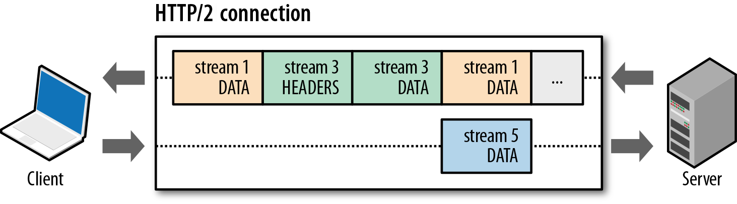
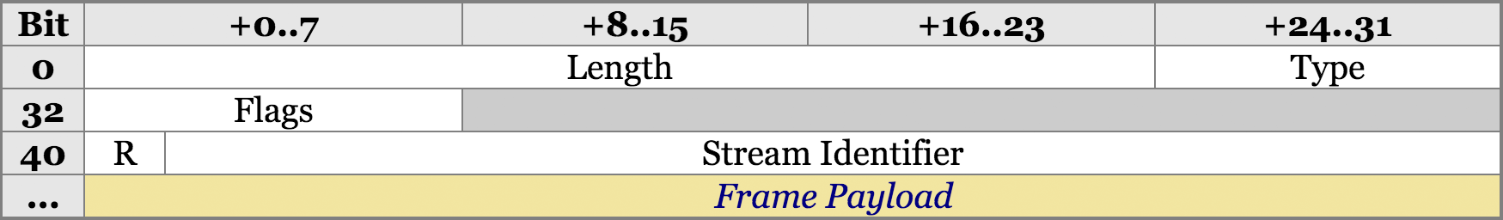
HTTP/2 Design: Multi-Streams
HTTP/2 Binary Framing
https://hpbn.co/http2/
https://tools.ietf.org/html/rfc7540

Slide 10
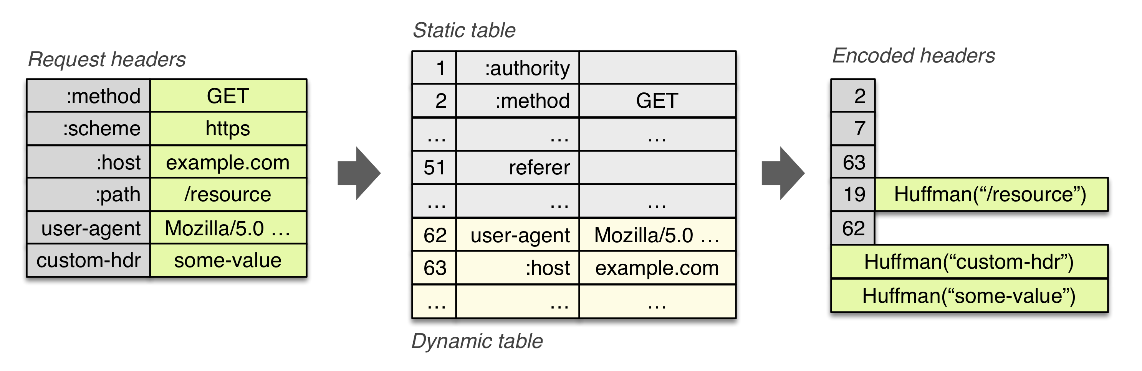
HTTP/2 Header Compression

Slide 11
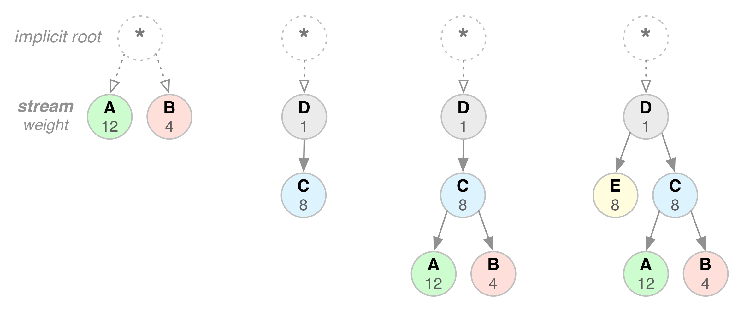
HTTP/2 Stream Dependency and Weights

Slide 12
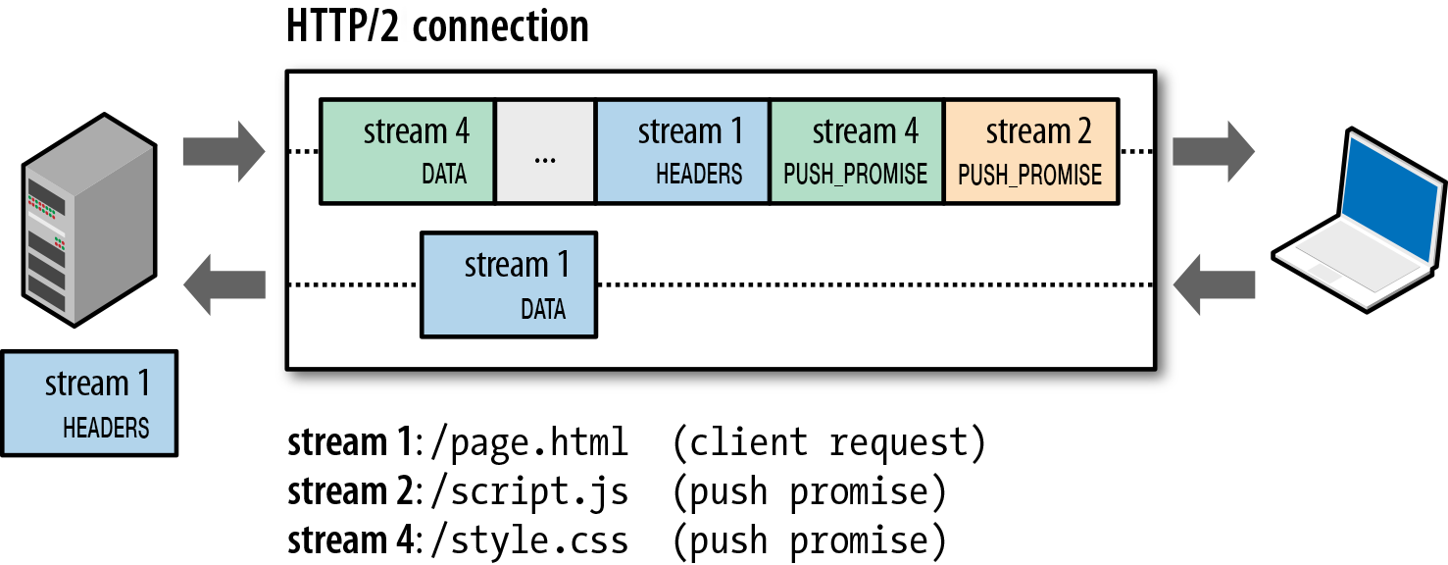
HTTP/2 Server Push

Slide 13
Outline
Admin and recap
HTTP
HTTP "acceleration"
Operational analysis

Slide 14
Goal: Best Server Design Limited Only by Resource Bottleneck
CPU
DISK
Before
NET
CPU
DISK
After
NET

Slide 15
Some Questions
When is CPU the bottleneck for scalability?
So that we need to add helper threads
How do we know that we are reaching the limit of scalability of a single machine?
These questions drive network server architecture design
Some basic performance analysis techniques are good to have

Slide 16

Background: Little’s Law (1961)
For any system with no or (low) loss.
Assume
mean arrival rate λ, mean time R at system, and mean number Q of requests at system
Then relationship between Q, λ, and R:
R, Q
λ
Example: XMU admits 3000 students each year, and mean time a student stays is 4 years, how many students are enrolled?
Notes:
Proof of Little’s Law:

Slide 17
Little’s Law: Proof
arrival
A
3
2
1
t
time

Slide 18
Operational Analysis
Relationships that do not require any assumptions about the distribution of service times or inter-arrival times
Hence focus on measurements
Identified originally by Buzen (1976) and later extended by Denning and Buzen (1978).
We touch only some techniques/results
In particular, bottleneck analysis
More details see linked reading

Slide 19
Under the Hood (An example FSM)
exit
(throughput λ until some
center saturates)
start (arrival rate λ)
CPU
I/O request
File I/O
network
Memory cache

Slide 20
Operational Analysis: Resource Demand of a Request
CPU
V_{CPU} visits for S_{CPU} units of resource time per visit
Network
V_{Net} visits for S_{Net} units of resource time per visit
Disk
V_{Disk} visits for S_{Disk} units of resource time per visit
Memory
V_{Mem} visits for S_{Mem} units of resource time per visit

Slide 21
Operational Quantities
T: observation interval Ai: # arrivals to device i
Bi: busy time of device i Ci: # completions at device i
i = 0 denotes system

Slide 22
Utilization Law
The law is independent of any assumption on arrival/service process
Example: Suppose NIC processes 125 pkts/sec, and each pkt takes 2 ms. What is utilization of the network NIC?

Slide 23
Deriving Relationship Between R, U, and S for one Device
Assume flow balanced (arrival=throughput), Little’s Law:
Assume PASTA (Poisson arrival--memory-less arrival--sees time average), a new request sees Q ahead of it, and FIFO
According to utilization law, U = XS

Slide 24
Forced Flow Law
Assume each request visits device i Vi times

Slide 25
Bottleneck Device
Define Di = Vi Si as the total demand of a request on device i
The device with the highest Di has the highest utilization, and thus is called the bottleneck

Slide 26
Bottleneck vs System Throughput

Slide 27
Example 1
A request may need
10 ms CPU execution time
1 Mbytes network bw
1 Mbytes file access where
50% hit in memory cache
Suppose network bw is 100 Mbps, disk I/O rate is 1 ms per 8 Kbytes (assuming the program reads 8 KB each time)
Where is the bottleneck?

Slide 28
Example 1 (cont.)
CPU:
D_{CPU}=
Network:
D_{Net} =
Disk I/O:
Ddisk =
10 ms ( e.q. 100 requests/s)
1 Mbytes / 100 Mbps = 80 ms (e.q., 12.5 requests/s)
0.5 * 1 ms * 1M/8K = 62.5 ms (e.q. = 16 requests/s)

Slide 29
Example 2
A request may need
150 ms CPU execution time (e.g., dynamic content)
1 Mbytes network bw
1 Mbytes file access where
50% hit in memory cache
Suppose network bw is 100 Mbps, disk I/O rate is 1 ms per 8 Kbytes (assuming the program reads 8 KB each time)
Bottleneck: CPU -> use multiple threads to use more CPUs, if available, to avoid CPU as bottleneck

Slide 30
Interactive Response Time Law
System setup
Closed system with N users
Each user sends in a request, after response, think time, and then sends next request
Notation
Z = user think-time, R = Response time
The total cycle time of a user request is R+Z
In duration T, #requests generated by each user:
T/(R+Z) requests

Slide 31
Interactive Response Time Law
If N users and flow balanced:

Slide 32
Bottleneck Analysis
Here D is the sum of Di

Slide 33
Proof
We know
Using interactive response time law:

Slide 34
Summary: Operational Laws
Utilization law: U = XS
Forced flow law: Xi = Vi X
Bottleneck device: largest Di = Vi Si
Little’s Law: Qi = Xi Ri
Bottleneck bound of interactive response (for the given closed model):

Slide 35

In Practice: Common Bottlenecks
No more file descriptors
Sockets stuck in TIME_WAIT
High memory use (swapping)
CPU overload
Interrupt (IRQ) overload
[Aaron Bannert]

Slide 36
YouTube Design Alg.
http://video.google.com/videoplay?docid=-6304964351441328559#
while (true) { identify_and_fix_bottlenecks(); drink(); sleep(); notice_new_bottleneck(); }

Slide 37
Summary: High-Perf. Network Server
Avoid blocking (so that we can reach bottleneck throughput)
Introduce threads
Limit unlimited thread overhead
Thread pool, async io
Shared variables
Synchronization (lock, synchronized)
Avoid busy-wait
Wait/notify; FSM; asynchronous channel/Future/Handler
Extensibility/robustness
Language support/Design for interfaces
System modeling and measurements
Queueing analysis, operational analysis

Slide 38
Outline
Admin and recap
HTTP: single server
Multiple network servers
Why multiple network servers

Slide 39
Why Multiple Servers?
Scalability
Scaling beyond single server throughput
There is a fundamental limit on what a single server can
process (CPU/bw/disk throughput)
store (disk/memory)
Scaling beyond single geo location latency
There is a limit on the speed of light
Network detour and delay further increase the delay
Notes:
Facebook 12 M HTTP/sec
http://www.datadoghq.com/2013/07/the-best-of-velocity-and-devopsdays-2013-part-ii/

Slide 40
Why Multiple Servers?
Redundancy and fault tolerance
Administration/Maintenance (e.g., incremental upgrade)
Redundancy (e.g., to handle failures)

Slide 41
Why Multiple Servers?
System/software architecture
Resources may be naturally distributed at different machines (e.g., run a single copy of a database server due to single license; access to resource from third party)
Security (e.g., front end, business logic, and database)
Today we focus mostly on the first benefit, for homogeneous (replica) servers

Slide 42
Discussion: Key Technical Challenges in Using Multiple Servers

Slide 43
Outline
Recap
Single network server
Multiple network servers
Why multiple servers
Multiple servers basic mechanism: request routing

Slide 44
Request Routing: Overview
Site A
Site B
?
- Global request routing: select a server site for each request
- Local request routing: select a specific server at the chosen site
Internet
Client

Slide 45

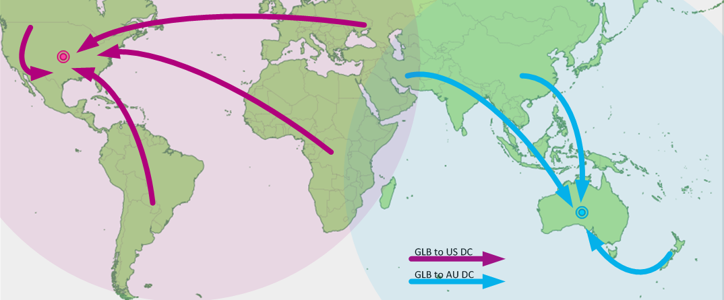
Request Routing: Overview
https://splash.riverbed.com/docs/DOC-1705

Slide 46
Request Routing: Basic Architecture
Site A
Site B
Major components
Server state monitoring
Load (incl. failed or not); what requests it can serve
Network path properties estimation
E.g., bw, delay, loss, network cost between clients and servers
Server assignment alg.
Request direction mechanism
?
Internet
Client
Notes:
What are challenges of each component?

Slide 47
Request Routing: Basic Architecture
server
state
net state: path property between servers/clients
server
selection algorithm
notify client
about selection (direction mech.)
requests

Slide 48
Network Path Properties
Why is the problem difficult?
Scalability: if do measurements, complete measurements grow with N * M, where
N is # of clients
M is # of servers
Complexity/feasibility in computing path metrics
M
N

Slide 49
Network Path Properties: Improve Scalability
Aggregation:
merge a set of IP addresses (reduce N and M)
E.g., when computing path properties, aggregates all clients sharing the same local DNS server
Sampling and prediction
Instead of measuring N*M entries, we measure a subset and predict the unmeasured paths
We will cover it later in the course
M servers
N’~100K local DNS servers
N~all Internet clients

Slide 50
Server Assignment
Why is the problem difficult?
What are potential problems of just sending each new client to the lightest load server?

Slide 51
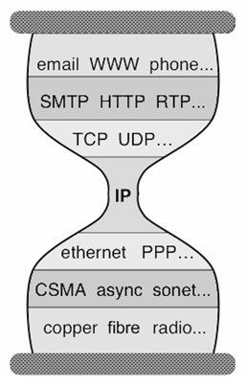
Client Direction Mechanisms
Key difficulty
May need to handle a large of clients
Basic types of mechanisms
Application layer, e.g.,
App/user is given a list of candidate server names
HTTP redirector
DNS: name resolution gives a list of server addresses
IP layer: Same IP address represents multiple physical servers
IP anycast: Same IP address shared by multiple servers and announced at different parts of the Internet. Network directs different clients to different servers
Smart-switch indirection: a server IP address may be a virtual IP address for a cluster of physical servers

Slide 52
Direction Mechanisms are Often Combined
App
DNS name1
DNS name2
IP1
IP2
IPn
Cluster1 in US East
Cluster2
in US West
Cluster2
in Europe
Load
balancer
Load
balancer
proxy
servers

Slide 53
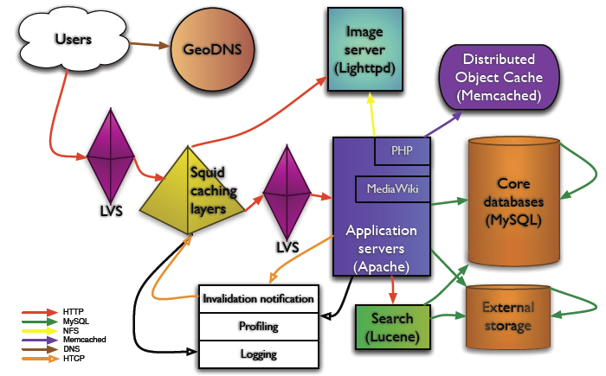
Example: Wikipedia Architecture
http://wikitech.wikimedia.org/images/8/81/Bergsma_-_Wikimedia_architecture_-_2007.pdf

Slide 54
Outline
Recap
Single, high-performance network server
Multiple network servers
Why multiple servers
Request routing mechanisms
Overview
Application-layer

Slide 55
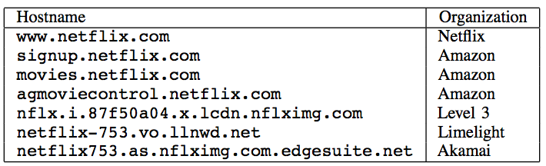
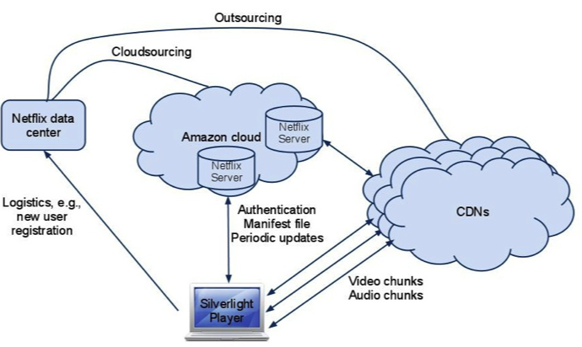
Example: Netflix

Slide 56
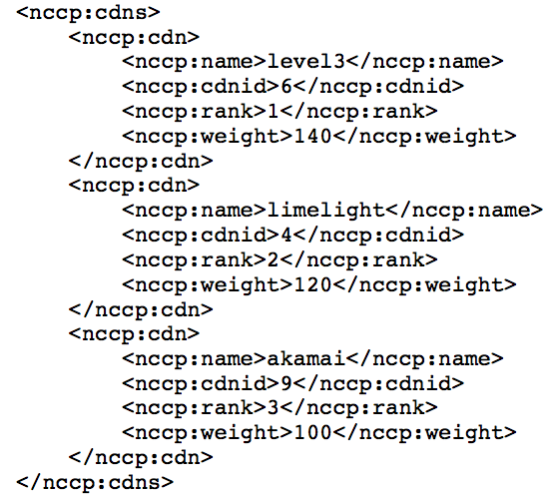
Example: Netflix Manifest File
Client player authenticates and then downloads manifest file from servers at Amazon Cloud

Slide 57
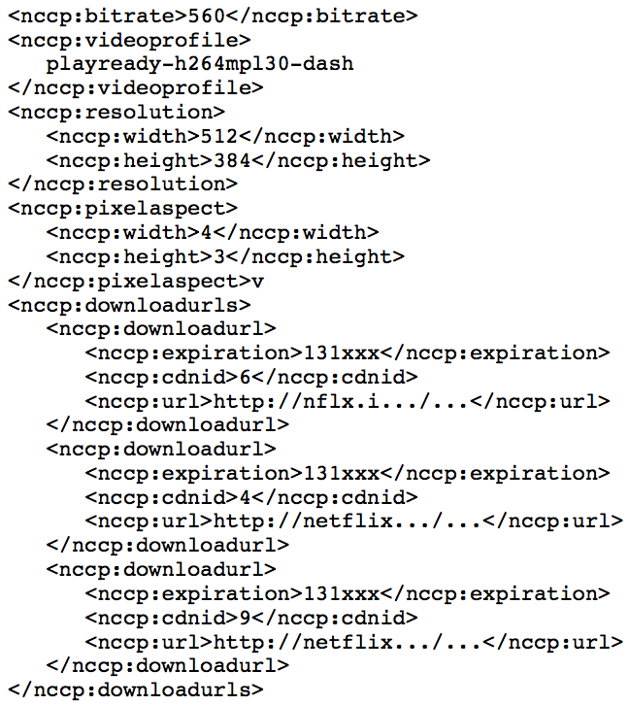
Example: Netflix Manifest File

Slide 58
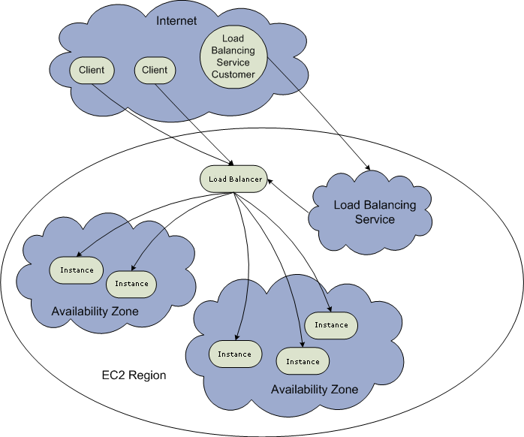
Example: Amazon Elastic Cloud 2 (EC2) Elastic Load Balancing
Use the create-load-balancer command to create an Elastic Load Balancer.
Use the register-instances -with-load-balancer command to register the Amazon EC2 instances that you want to load balance with the Elastic Load Balancer.
Elastic Load Balancing automatically checks the health of your load balancing Amazon EC2 instances. You can optionally customize the health checks by using the configure-healthcheck command.
Traffic to the DNS name provided by the Elastic Load Balancer is automatically distributed across healthy Amazon EC2 instances.
http://docs.aws.amazon.com/ElasticLoadBalancing/latest/DeveloperGuide/elastic-load-balancing.html

Slide 59
Details: Create Load Balancer
The operation returns the DNS name of your LoadBalancer. You can then map that to any other domain name (such as www.mywebsite.com) (how?) %aws elb create-load-balancer --load-balancer-name my-load-balancer --listeners "Protocol=HTTP,LoadBalancerPort=80,InstanceProtocol=HTTP,InstancePort=80" --availability-zones us-west-2a us-west-2b Result:
{ "DNSName": "my-load-balancer-123456789.us-west-2.elb.amazonaws.com”}
http://docs.aws.amazon.com/cli/latest/reference/elb/create-load-balancer.html

Slide 60
Details: Configure Health Check
The operation configures how instances are monitored, e.g., %aws elb configure-health-check --load-balancer-name my-load-balancer --health-check Target=HTTP:80/png,Interval=30,UnhealthyThreshold=2,HealthyThreshold=2,Timeout=3
Result:
{
"HealthCheck": {
"HealthyThreshold": 2,
"Interval": 30,
"Target": "HTTP:80/png",
"Timeout": 3,
"UnhealthyThreshold": 2
}
http://docs.aws.amazon.com/cli/latest/reference/elb/configure-health-check.html

Slide 61
Details: Register Instances
The operation registers instances that can receive traffic, %aws elb register-instances-with-load-balancer --load-balancer-name my-load-balancer --instances i-d6f6fae3
Result:
{ "Instances": [ {"InstanceId": "i-d6f6fae3“},
{"InstanceId": "i-207d9717“},
{"InstanceId": "i-afefb49b“}
]
}
http://docs.aws.amazon.com/cli/latest/reference/elb/register-instances-with-load-balancer.html

Slide 62
Outline
Recap
Single network server
Multiple network servers
Why multiple servers
Request routing mechanisms
Overview
Application-layer
DNS

Slide 63


Basic DNS Indirection and Rotation
%dig cnn.com
157.166.226.25
router
157.166.226.26
IP address
of cnn.com
157.166.255.18
157.166.226.25
157.166.226.26
IP address
of cnn.com
DNS server for cnn.com
157.166.226.26
157.166.226.25

Slide 64
CDN Using DNS (Akamai Architecture as an Example)
Content publisher (e.g., cnn)
provides base HTML documents
runs origin server(s); but delegates heavy-weight content (e.g., images) to CDN
Akamai runs
(~240,000) edge servers for hosting content
Deployment into 130 countries and 1600 networks
Claims 85% Internet users are within a single "network hop" of an Akamai CDN server.
customized DNS redirection servers to select edge servers based on
closeness to client browser, server load
Source: https://www.akamai.com/us/en/about/facts-figures.jsp

Slide 65
Linking to Akamai
Originally, URL Akamaization of embedded content: e.g.,
<IMG SRC= http://www.provider.com/image.gif > changed to
<IMG SRC = http://a661. g.akamai.net/hash/image.gif>
URL Akamaization is becoming obsolete and supported mostly for legacy reasons
Note that this DNS redirection unit is per customer, not individual files.

Slide 66
Exercise
Check any web page of nba.com and find a page with an image
Find the URL
Use %dig [+trace] to see DNS load direction
https://www.nba.com/news/reports-lakers-extend-gm-rob-pelinka-through-2025-26-season
Notes:
https://media.cnn.com/api/v1/images/stellar/prod/221007114404-01-kogi-nigeria-floods.jpg?c=16x9&q=h_720,w_1280,c_fill

Slide 67
Recap: CNAME based DNS Name
Typical design
Use cname to create aliases, e.g., https://cdn.nba.com/manage/2021/08/GettyImages-1234610091-scaled-e1665274852371-1568x882.jpg
cname: e8017.dscb.akamaiedge.net
why two levels in the name?

Slide 68
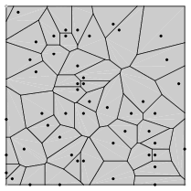
Two-Level Direction
high-level DNS determines proximity, directs to low-level DNS;
low-level DNS: who manages a close-by cluster of servers with different IP addresses
Input: dscb.akamaiedge.net & and client IP,
Output: region (low-level) DNS
Input: e8017.dscb.akamaiedge.net & and client IP
Output: specific servers

Slide 69
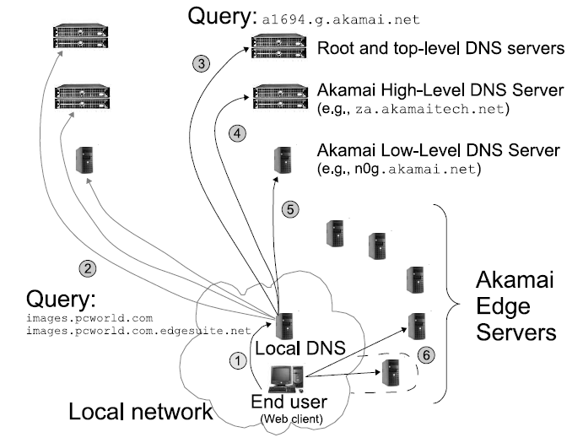
Akamai Load Direction
If the directed edge server does not have requested content,
it goes back to the original server (source) .
Notes:
High-level DNS determines client location and forward to the corresponding low level DNS

Slide 70
Two-Level DNS Mapping Alg
High-level
Typically geo-location matching from client to reg
Low-level
Typically secret, e.g., details of Akamai algorithms are proprietary
Typical goal: load balancing among servers

Slide 71
Akamai Local DNS LB Alg
A Bin-Packing algorithm (column 12 of Akamai Patent) every T second
Compute the load to each publisher k (called serial number)
Sort the publishers from increasing load
For each publisher, associate a list of random servers generated by a hash function
Hash range may be increasing, e.g., first hash [0,1], second [0, 3]
Assign the publisher to the first server that does not overload

Slide 72


Experimental Study of Akamai Load Balancing
Methodology
2-months long measurement
140 PlanetLab nodes (clients)
50 US and Canada, 35 Europe, 18 Asia, 8 South America, the rest randomly scattered
Every 20 sec, each client queries an appropriate CNAME for Yahoo, CNN, Fox News, NY Times, etc.
Akamai
Web replica 1
Akamai Low-Level
DNS Server
Akamai
Web replica 2
.……
Akamai
Web replica 3
Web client
See http://www.aqualab.cs.northwestern.edu/publications/Ajsu06DBA.pdf

Slide 73
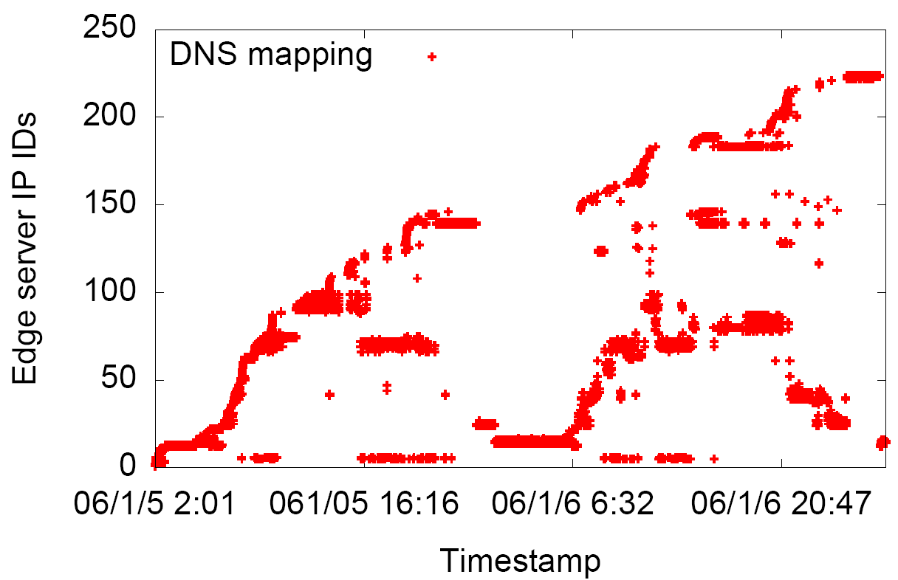
Server Pool: to Yahoo
Target: a943.x.a.yimg.com (Yahoo)
Client 1: Berkeley
Client 2: Purdue
day
Web replica IDs
Web replica IDs
06/1/05 16:16
night

Slide 74
Server Diversity for Yahoo
Majority of PL nodes
see between 10 and 50
Akamai edge-servers
Nodes far away
from Akamai
hot-spots
74

Slide 75
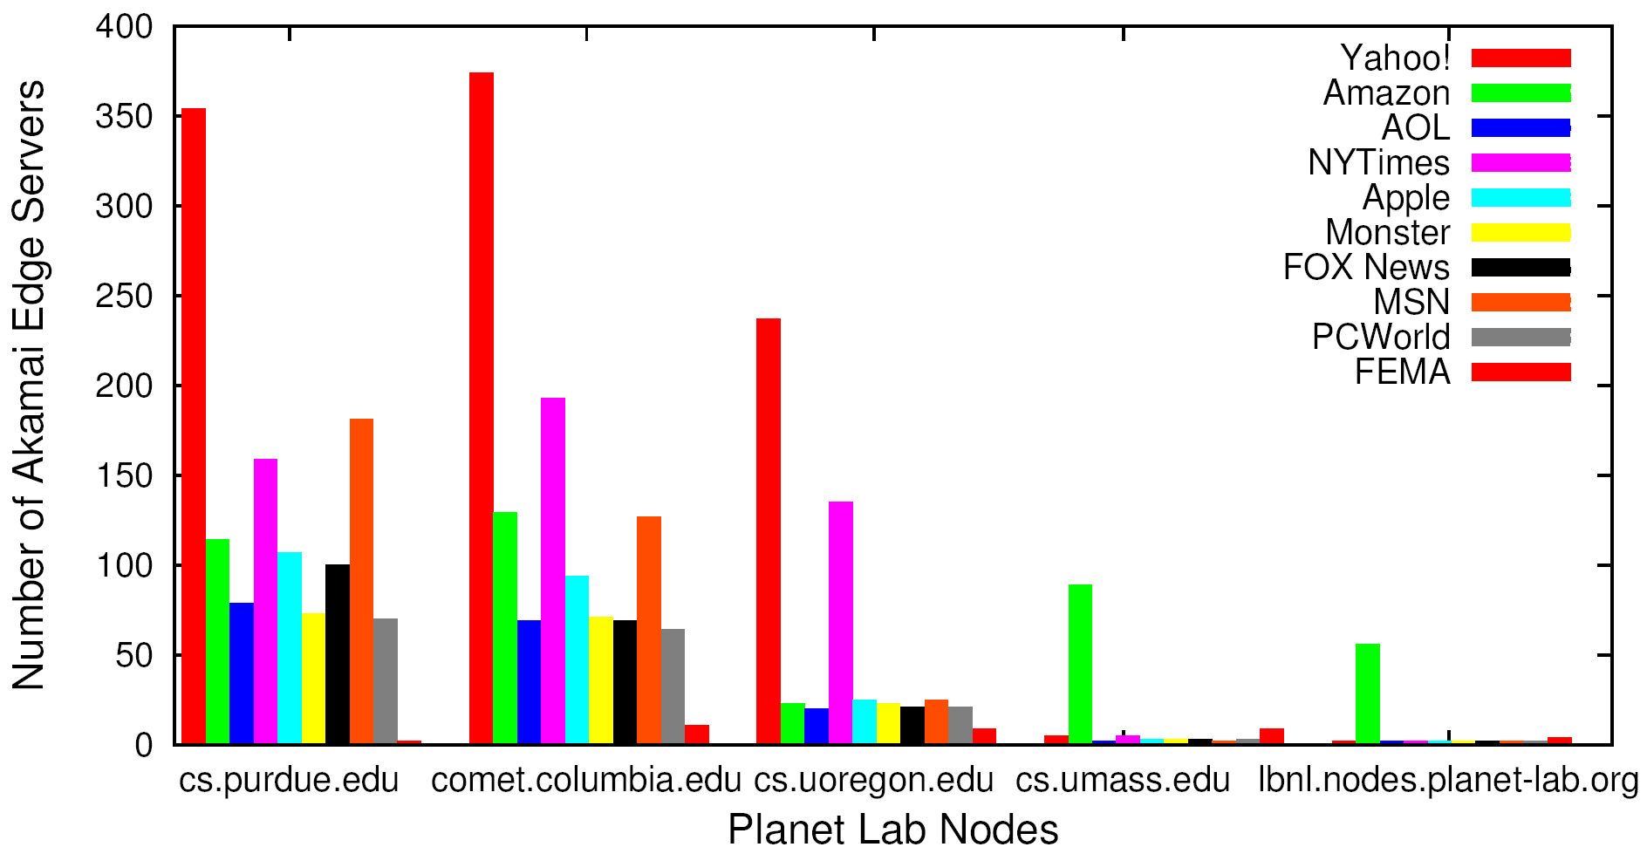
Server Pool: Multiple Akamai Hosted Sites
Number of Akamai Web Replicas
Clients

Slide 76
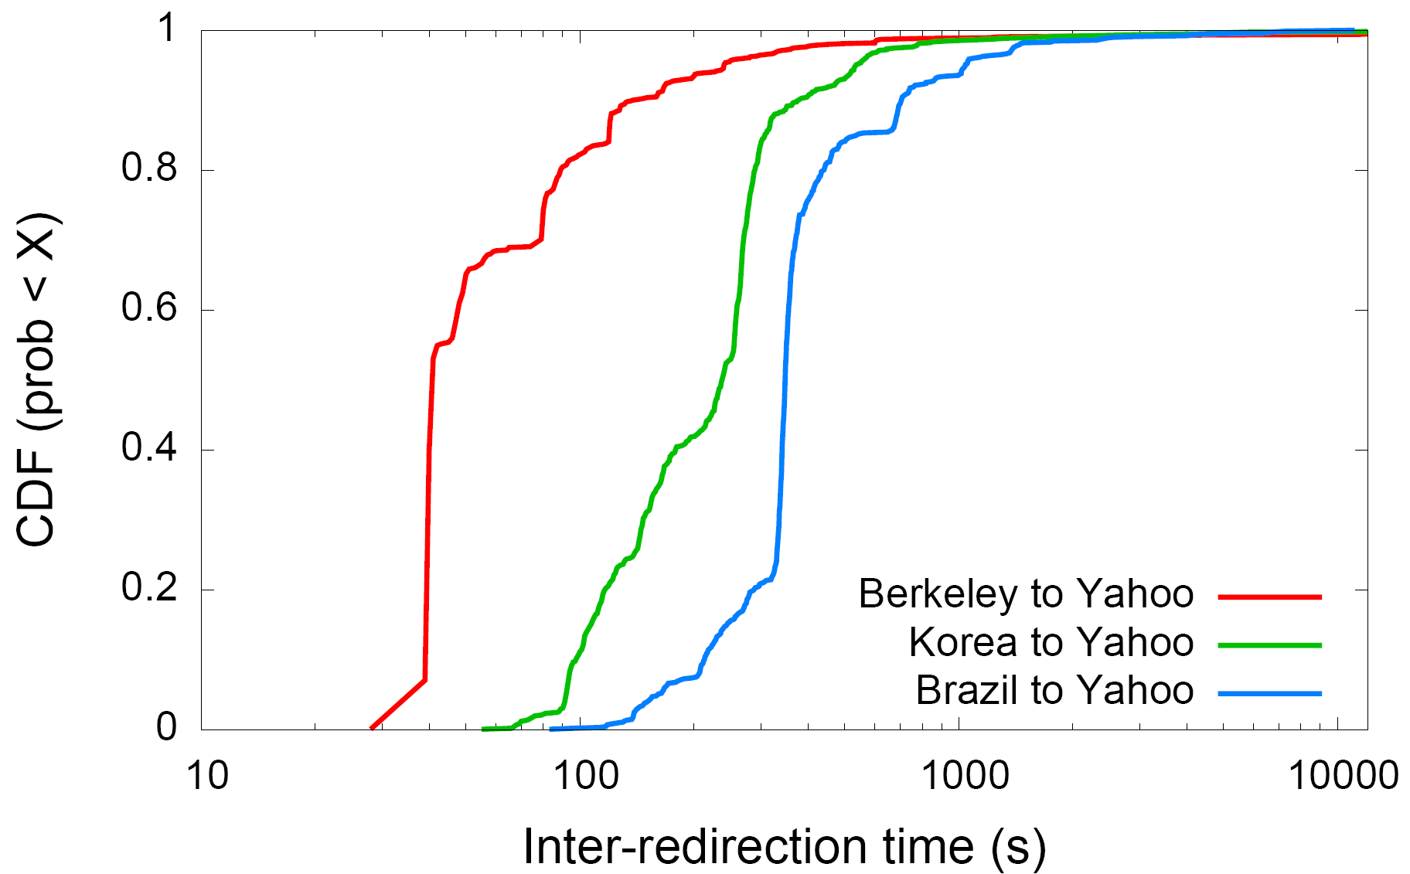
Load Balancing Dynamics
Berkeley
Brazil
Korea
76
Notes:
50% of the redirections are shorter than 40 seconds (Berkeley as example)

Slide 77

Redirection Effectiveness: Measurement Methodology
10 Best
Akamai
Replica Servers
………
ping
ping
ping
ping
Akamai Low-Level
DNS Server
Planet Lab Node
Notes:
Decouple server latency from network latency

Slide 78
Do redirections reveal network conditions?
Rank = r1+r2-1, where ri is rank of server i
16 means perfect correlation
0 means poor correlation
MIT and Amsterdam
are excellent
Brazil is poor

Slide 79
(Offline Read) Facebook DNS Load Direction
A system named Cartographer (written in Python) processes measurement data and configures the DNS maps of individual DNS servers (open source tinydns)
Notes:
https://splash.riverbed.com/docs/DOC-1705
Adam Lazur from the Traffic Team at Facebook gave a well-attended talk about the new load balancing architecture that Facebook had to come up with to deal with a billion users spread out over the entire planet. Adam gave us a glimpse into Facebook’s massive traffic handling.
A billion users means for Facebook over 12 million HTTP requests per second. To handle the load, traffic is first handled by a few TCP proxies, which then forward HTTP traffic to a larger group of HTTP proxies, which themselves sit in front of a even larger number of servers.
The geographical distribution of their users is such that the first act of load balancing is handled by DNS. Having an out-of-date DNS configuration means sending a lot of users’ HTTP queries to data centers that are not optimally close to them. And that translates pretty directly into slower requests (and less user engagement).
Most of the presentation was spent of Cartographer, a dynamic configuration engine for DNS. The job of Cartographer is to continuously provision Facebook’s DNS servers with a configuration that is updated based on various network conditions.
Aside from the technology, Adam’s talk was particularly candid about the initial results, their rollout strategy and the times they had to to fix things as they rolled out new versions (fairly quickly at that).

Slide 80
Discussion
Advantages of using DNS for using multiple servers (LB)
Leveraging existing DNS features (e.g., cname, hierarchy name for natural hierarchical redirection)
Leveraging existing DNS deployment/optimization
Disadvantages of using DNS
Distributed caching may lead to slow response
Only in the unit of IP addresses

Slide 81
Recap: Direction Mechanisms
App
DNS name1
DNS name2
IP1
IP2
IPn
Cluster1 in US East
Cluster2
in US West
Cluster2
in Europe
Load
balancer
Load
balancer
proxy
servers

Slide 82
Outline
Recap
Single, high-performance network server
Multiple network servers
Basic issues
Load direction
DNS (IP level)
Load balancer/smart switch (sub-IP level)

Slide 83
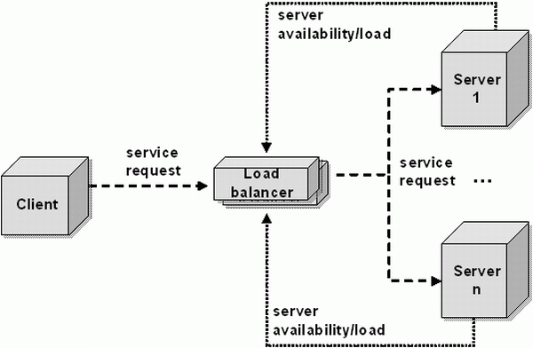
Smart Switch: Big Picture
smart switch

Slide 84
VIP Clustering
Goals
server load balancing
failure detection
access control filtering
priorities/QoS
request locality
transparent caching
L4: TCP
L7: HTTP
SSL
etc.
virtual IP addresses (VIPs)
smart switch
Clients
What to switch/filter on?
L3 source IP and/or VIP
L4 (TCP) ports etc.
L7 URLs and/or cookies
L7 SSL session IDs
server array

Slide 85
Load Balancer (LB): Basic Structure
RIP1
S=client
D=VIP
Server1
S=client
D=VIP
VIP
RIP2
Client
LB
Server2
RIP3
Server3
Problem of the basic structure?

Slide 86
Problem
S=client
D=VIP
Client to server packet has VIP as destination address, but real servers use RIPs
if LB just forwards the packet from client to a real server, the real server drops the packet
reply from real server to client has real server IP as source -> client will drop the packet
state: listening
address: {RealIP.6789, *:*}
completed connection queue: C1; C2 sendbuf:
recvbuf:
state:
address: {VIP:6789, 198.69.10.10.1500}
sendbuf:
recvbuf:
…
state:
address: {RealIP:6789, 198.69.10.10.1500}
sendbuf:
recvbuf:
…
server
client

